Slide 1
European Conference on Computer Vision
Jia Zheng

Slide 2
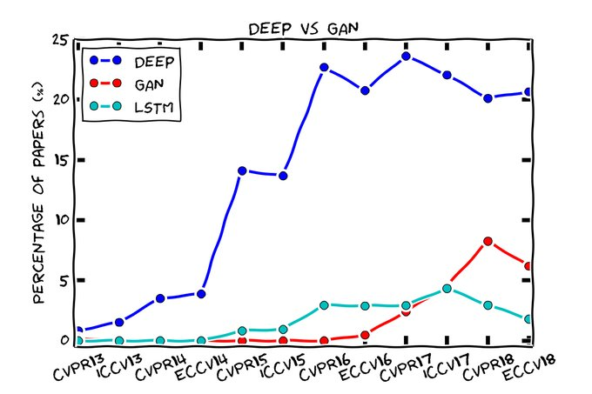
Jordi Pont-Tuset, “DEEP VS GAN.”, Retrieved from https://twitter.com/jponttuset, 2018.

Slide 3
Outline
Workshops
UltraFast 3D Sensing, Reconstruction and Understanding of People, Objects and Environments
The International Workshop on Video Segmentation
3rd Workshop on Geometry Meets Deep Learning
Main Conference
Oral
Poster

Slide 4
Workshop
UltraFast 3D Sensing, Reconstruction and Understanding of People, Objects and Environments

Slide 5
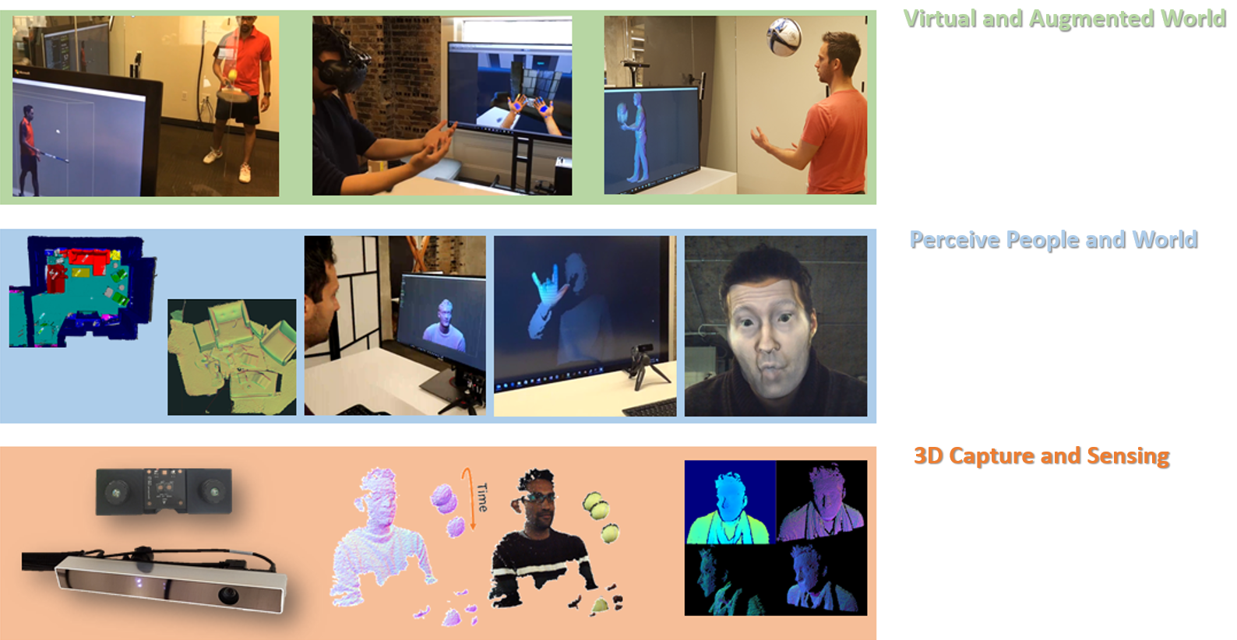
UltraFast 3D Sensing, Reconstruction and Understanding of People, Objects and Environments
https://augmentedperception.github.io/eccv18/

Slide 6
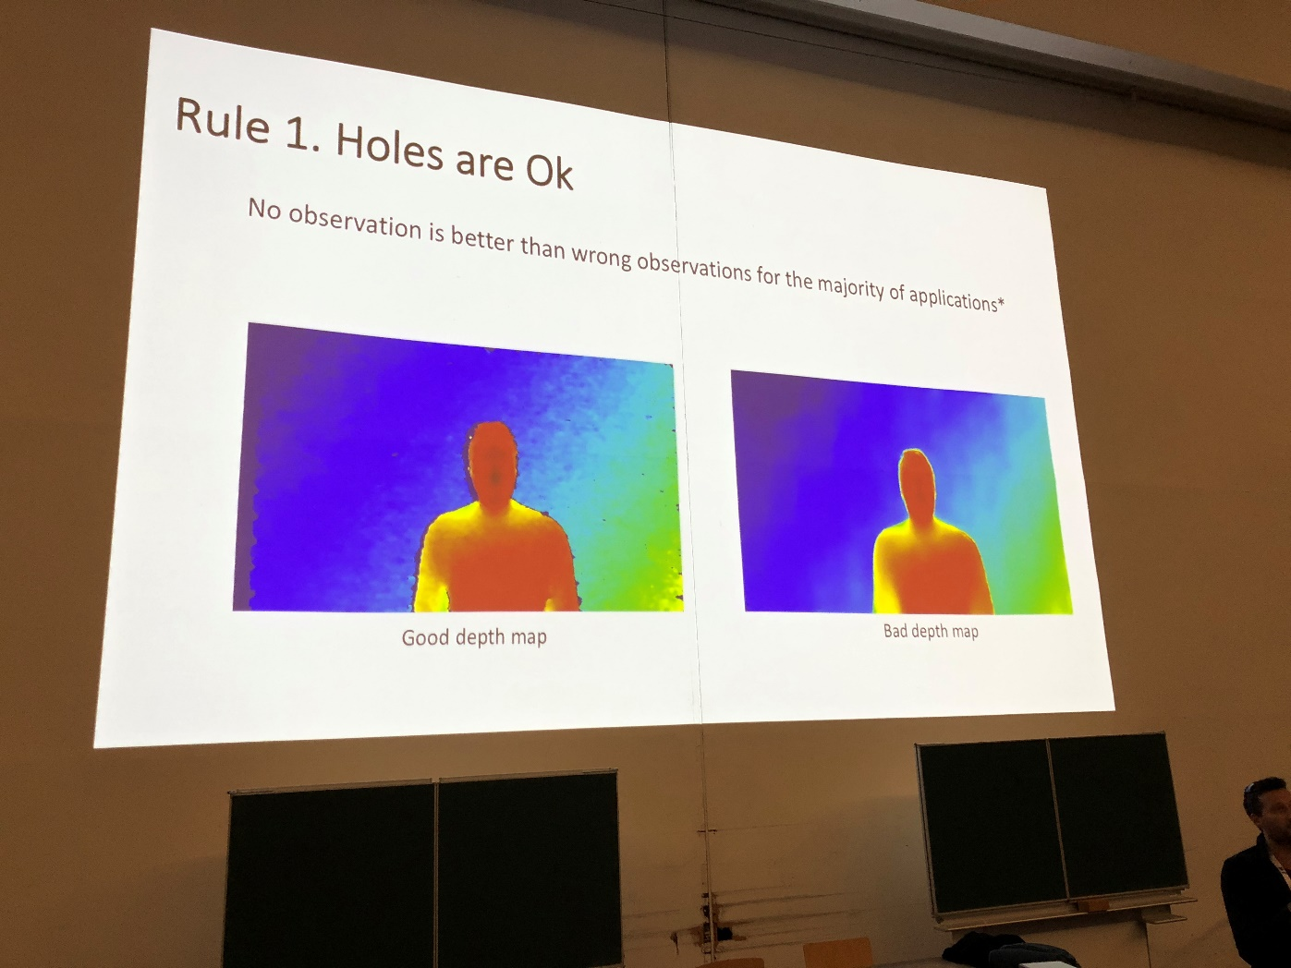
Good Depth Maps?
Sean Fanello, “Depth Sensors and Algorithms: What, When, Where”, 2018.

Slide 7
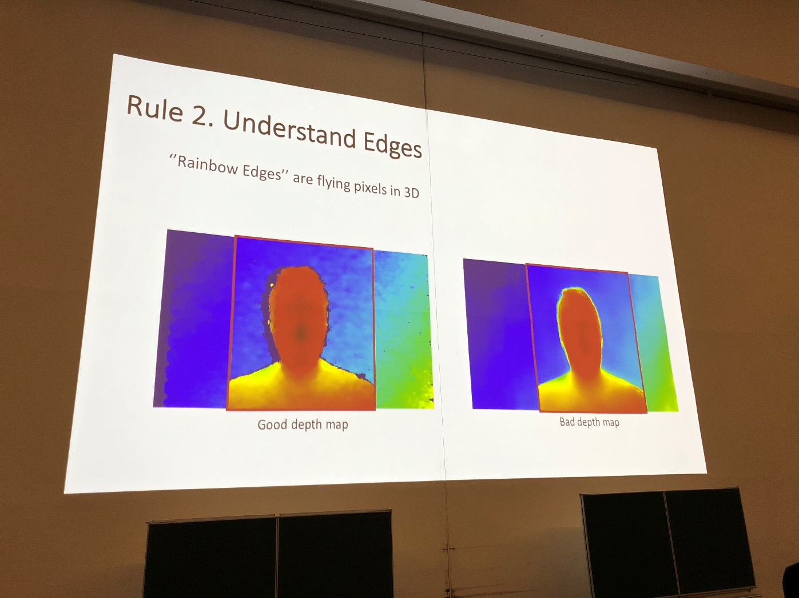
Good Depth Maps?
Sean Fanello, “Depth Sensors and Algorithms: What, When, Where”, 2018.

Slide 8
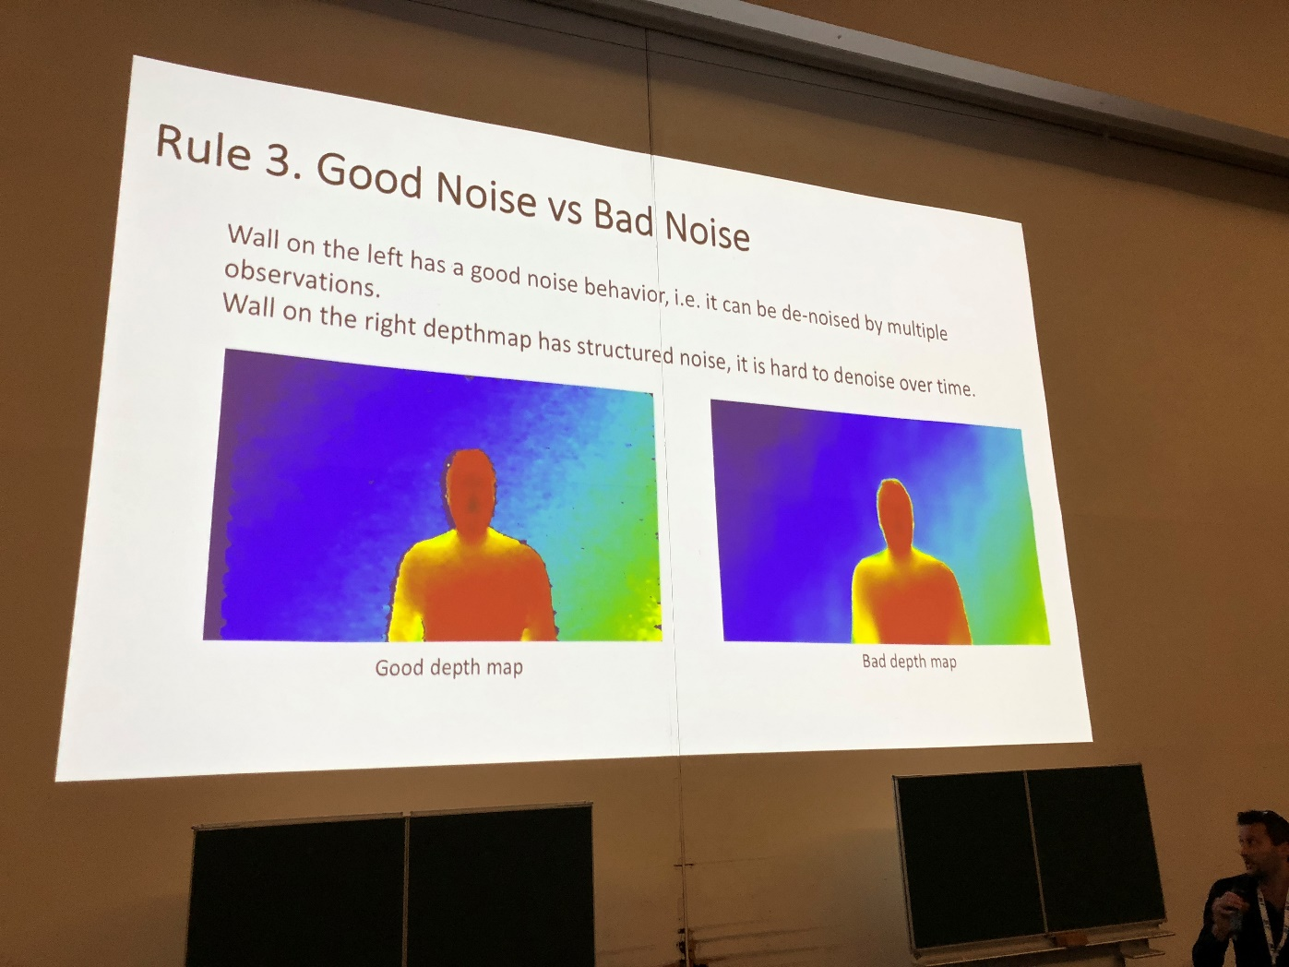
Good Depth Maps?
Sean Fanello, “Depth Sensors and Algorithms: What, When, Where”, 2018.

Slide 9
Workshop
The International Workshop on Video Segmentation

Slide 10
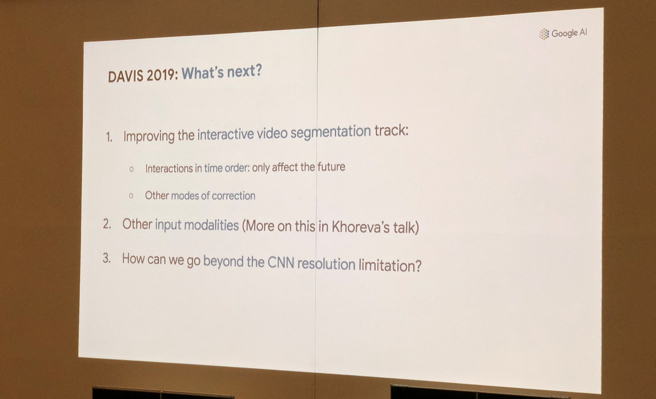
Jordi Pont-Tuset, “Two years of DAVIS: what we've learnt and what's next in video object segmentation”, 2018.

Slide 11
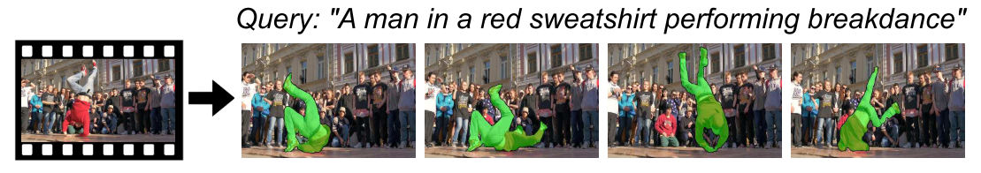
Input modality
A. Khoreva, A. Rohrbach, and B. Schiele, “Video Object Segmentation with Language Referring Expressions,” arXiv Prepr. arXiv1803.08006, 2018.

Slide 12
Workshop
3rd Workshop on Geometry Meets Deep Learning

Slide 13
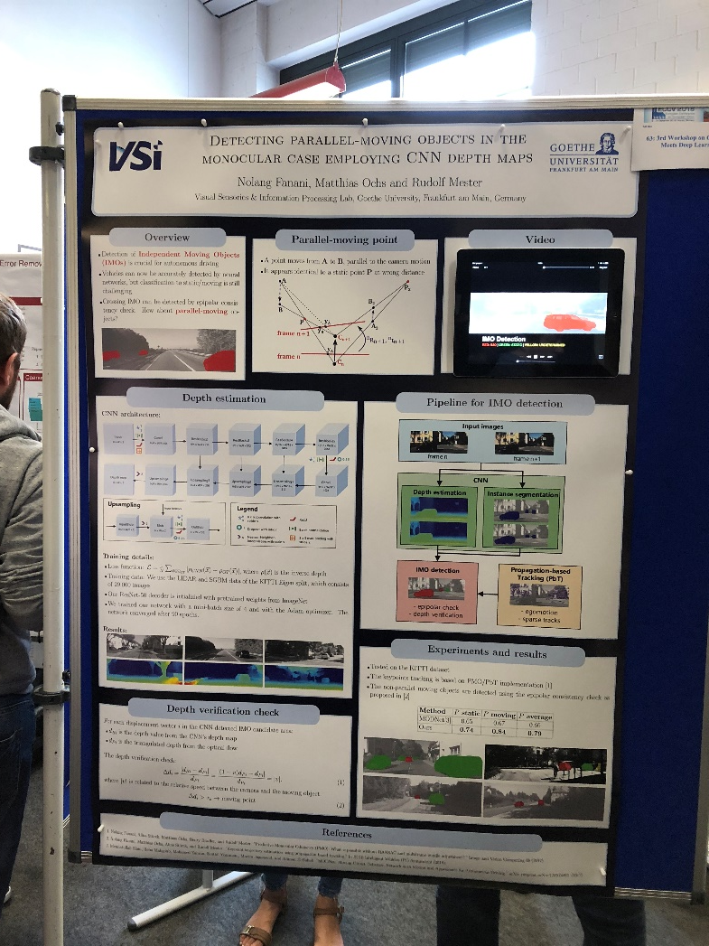
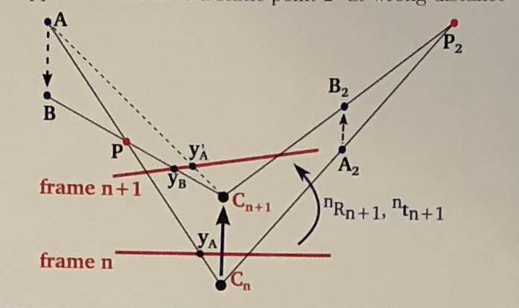
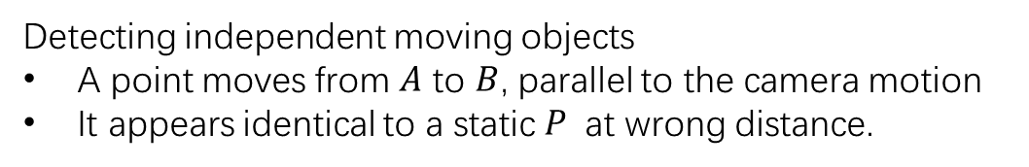
Detecting independent moving objects
A point moves from $A$ to $B$, parallel to the camera motion
It appears identical to a static $P$ at wrong distance.
N. Fanani, M. Ochs, and R. Mester, “Detecting parallel-moving objects in the monocular case employing CNN depth maps,” In ECCV Workshop, 2018.

Slide 14
Oral Session
Convolutional Networks with Adaptive Inference Graphs

Slide 15
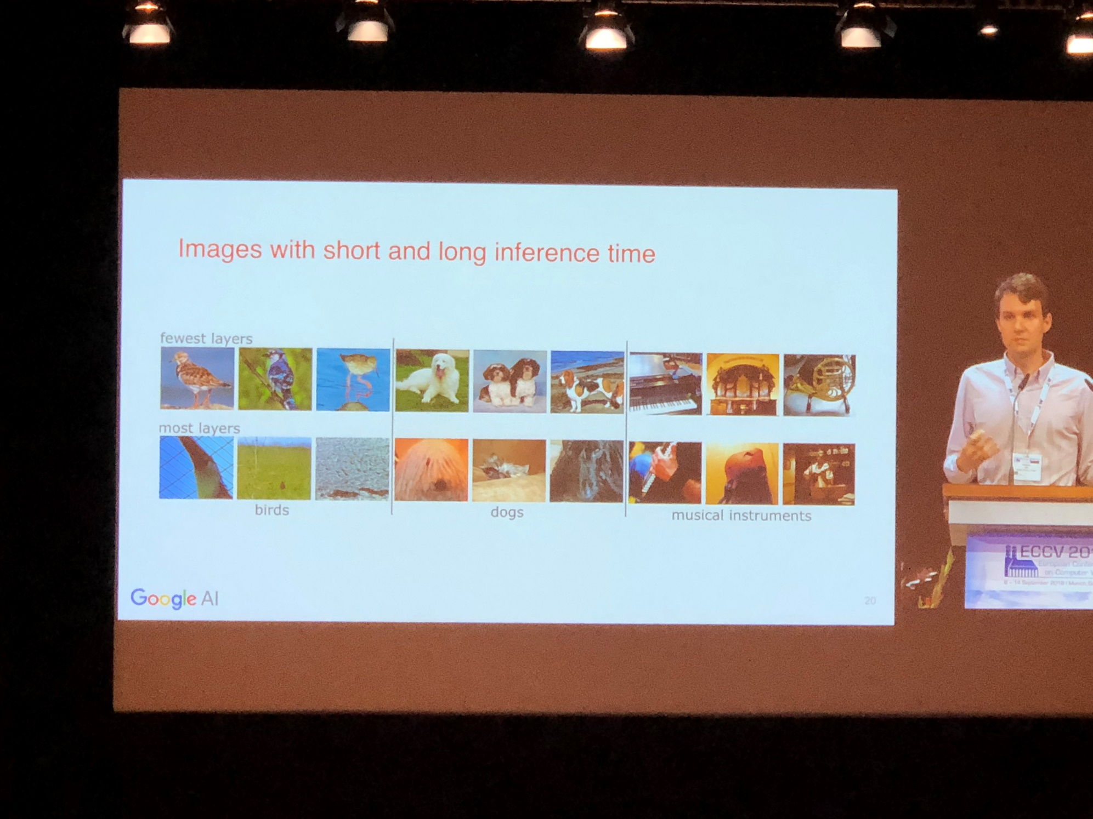
A. Veit, and S. Belongie, “Convolutional Networks with Adaptive Inference Graphs,” in ECCV, 2018.

Slide 16
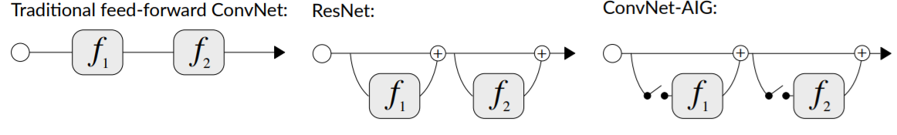
A. Veit, and S. Belongie, “Convolutional Networks with Adaptive Inference Graphs,” in ECCV, 2018.

Slide 17
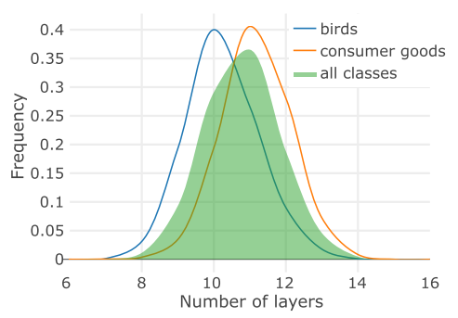
Distribution over the number of executed layers. For ConvNet- AIG 50 on ImageNet with target rate 0.4, in average 10.8 out of 16 residual layers are executed. Images of animals tend to use fewer layers than man-made objects.

Slide 18
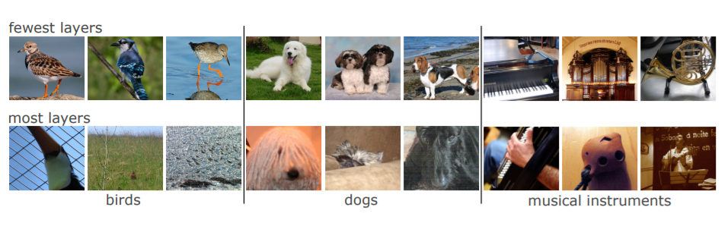
The examples highlight that easy instances with iconic views require only a few layers. Difficult instances that are small or occluded need more computation
A. Veit, and S. Belongie, “Convolutional Networks with Adaptive Inference Graphs,” in ECCV, 2018.

Slide 19
Poster Session
Superpixel Sampling Networks

Slide 20
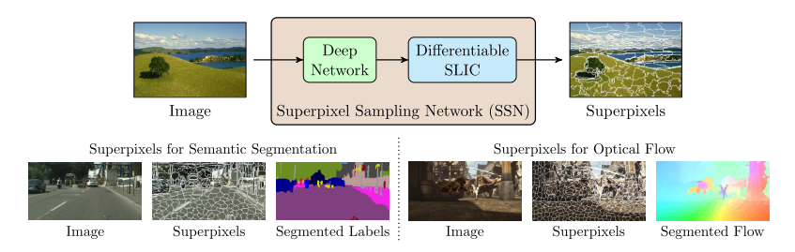
V. Jampani, D. Sun, M.-Y. Liu, M.-H. Yang, and J. Kautz, “Superpixel Sampling Networks,” in ECCV, 2018.

Slide 21
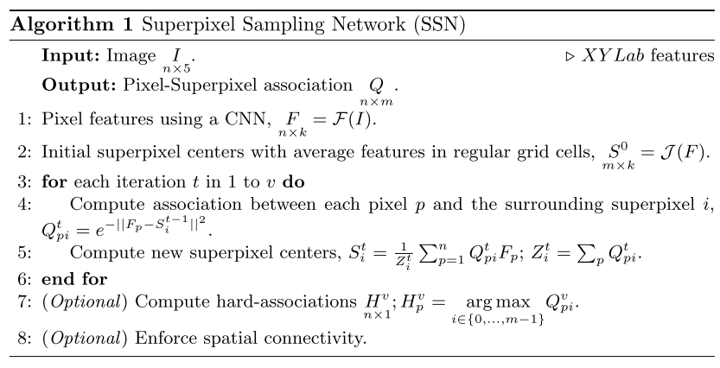
V. Jampani, D. Sun, M.-Y. Liu, M.-H. Yang, and J. Kautz, “Superpixel Sampling Networks,” in ECCV, 2018.

Slide 22
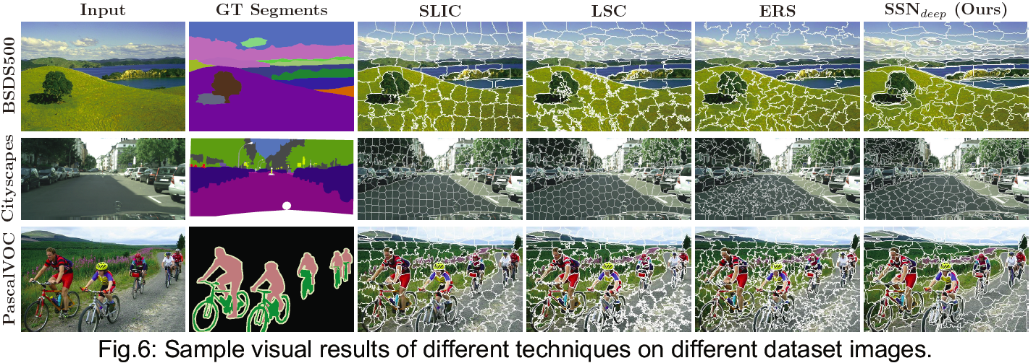
V. Jampani, D. Sun, M.-Y. Liu, M.-H. Yang, and J. Kautz, “Superpixel Sampling Networks,” in ECCV, 2018.

Slide 23
Poster Session
Learning to Segment via Cut-and-Paste

Slide 24
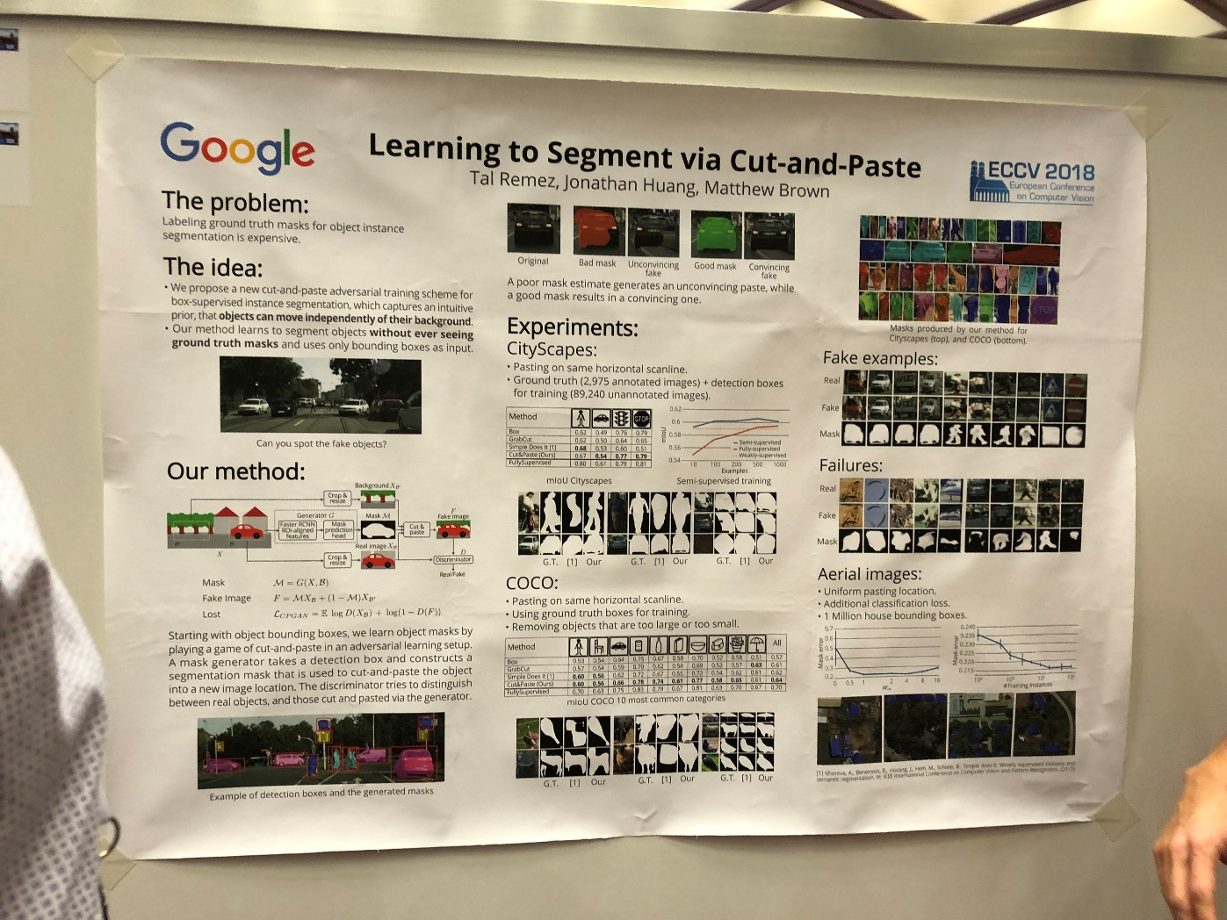
T. Remez, J. Huang, and M. Brown, “Learning to Segment via Cut-and-Paste,” in ECCV, 2018.

Slide 25
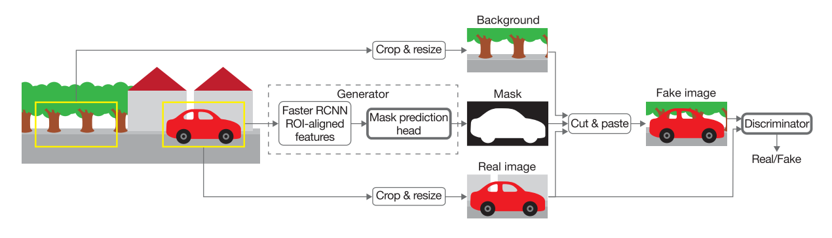
T. Remez, J. Huang, and M. Brown, “Learning to Segment via Cut-and-Paste,” in ECCV, 2018.

Slide 26
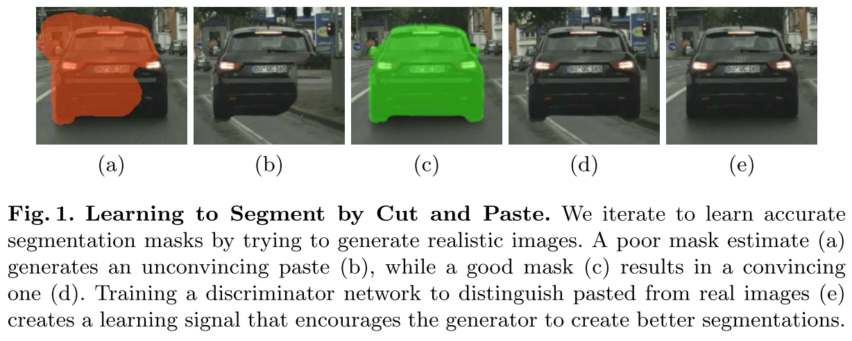
T. Remez, J. Huang, and M. Brown, “Learning to Segment via Cut-and-Paste,” in ECCV, 2018.

Slide 27
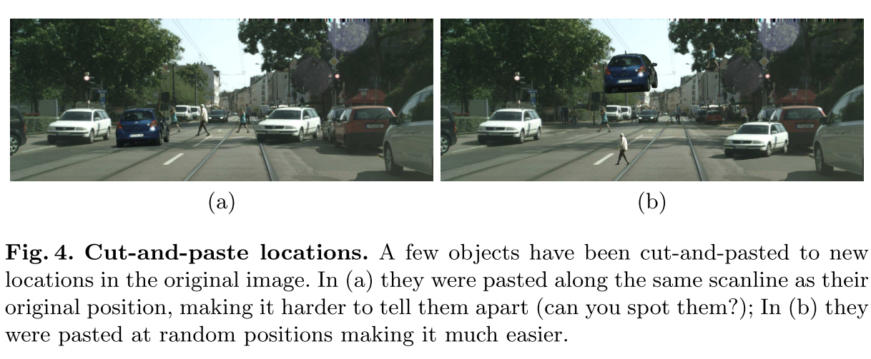
T. Remez, J. Huang, and M. Brown, “Learning to Segment via Cut-and-Paste,” in ECCV, 2018.

Slide 28
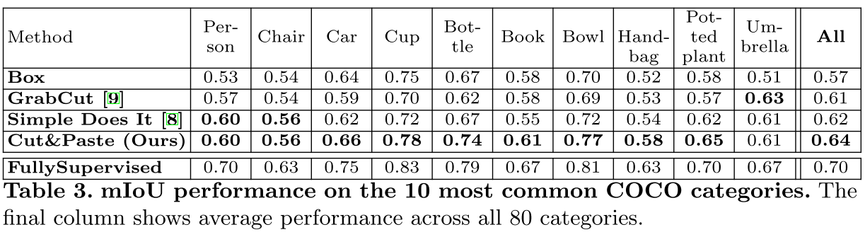
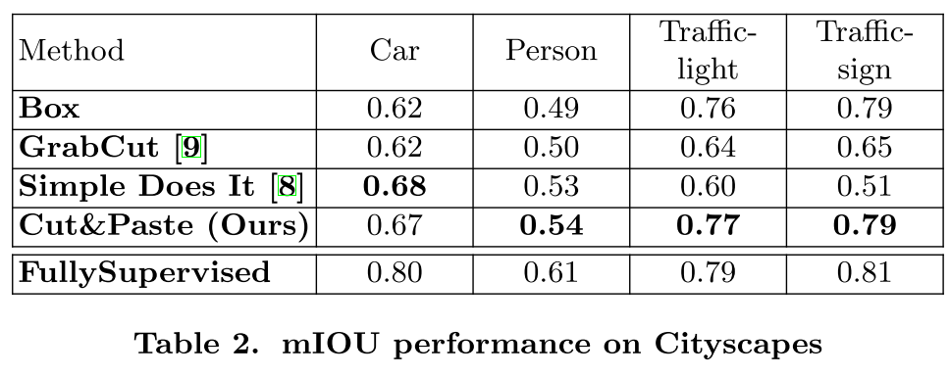
T. Remez, J. Huang, and M. Brown, “Learning to Segment via Cut-and-Paste,” in ECCV, 2018.

Slide 29
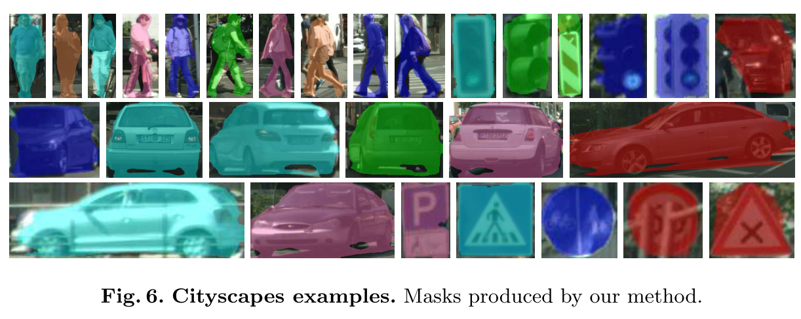
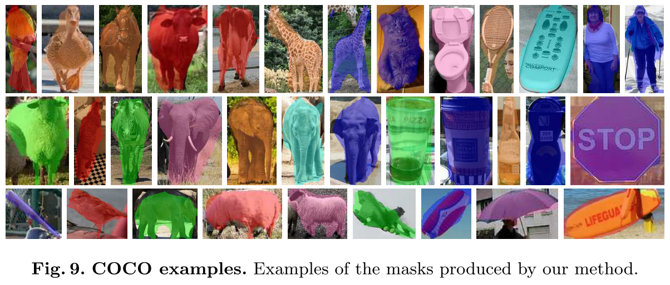
T. Remez, J. Huang, and M. Brown, “Learning to Segment via Cut-and-Paste,” in ECCV, 2018.

Slide 30
Poster Session
Extending Layered Models to 3D Motion

Slide 31
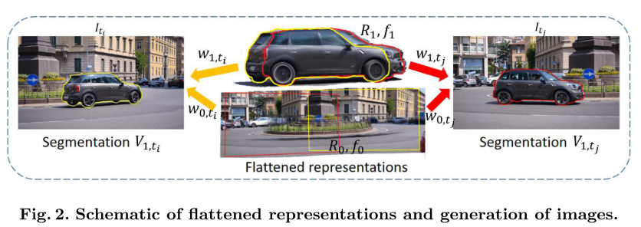
Infer a layered representation, its depth ordering and motion segmentation from video in which objects may undergo 3D non-planar motion relative to the camera.
D. Lao, and G. Sundaramoorthi, “Extending Layered Models to 3D Motion,” in ECCV, 2018.

Slide 32
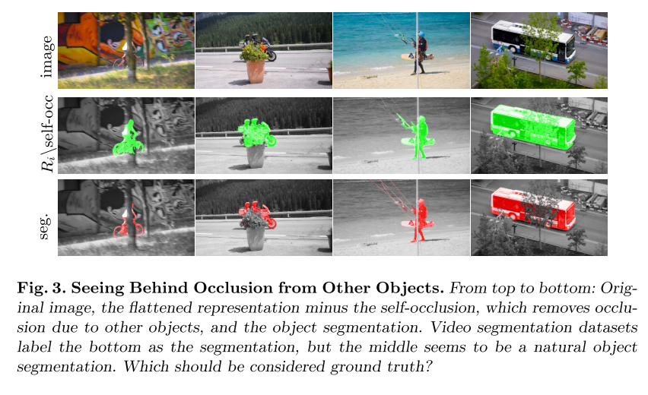
D. Lao, and G. Sundaramoorthi, “Extending Layered Models to 3D Motion,” in ECCV, 2018.

Slide 33
Thanks for Attention!

Slide 34
State-of-the-art approach

Slide 35
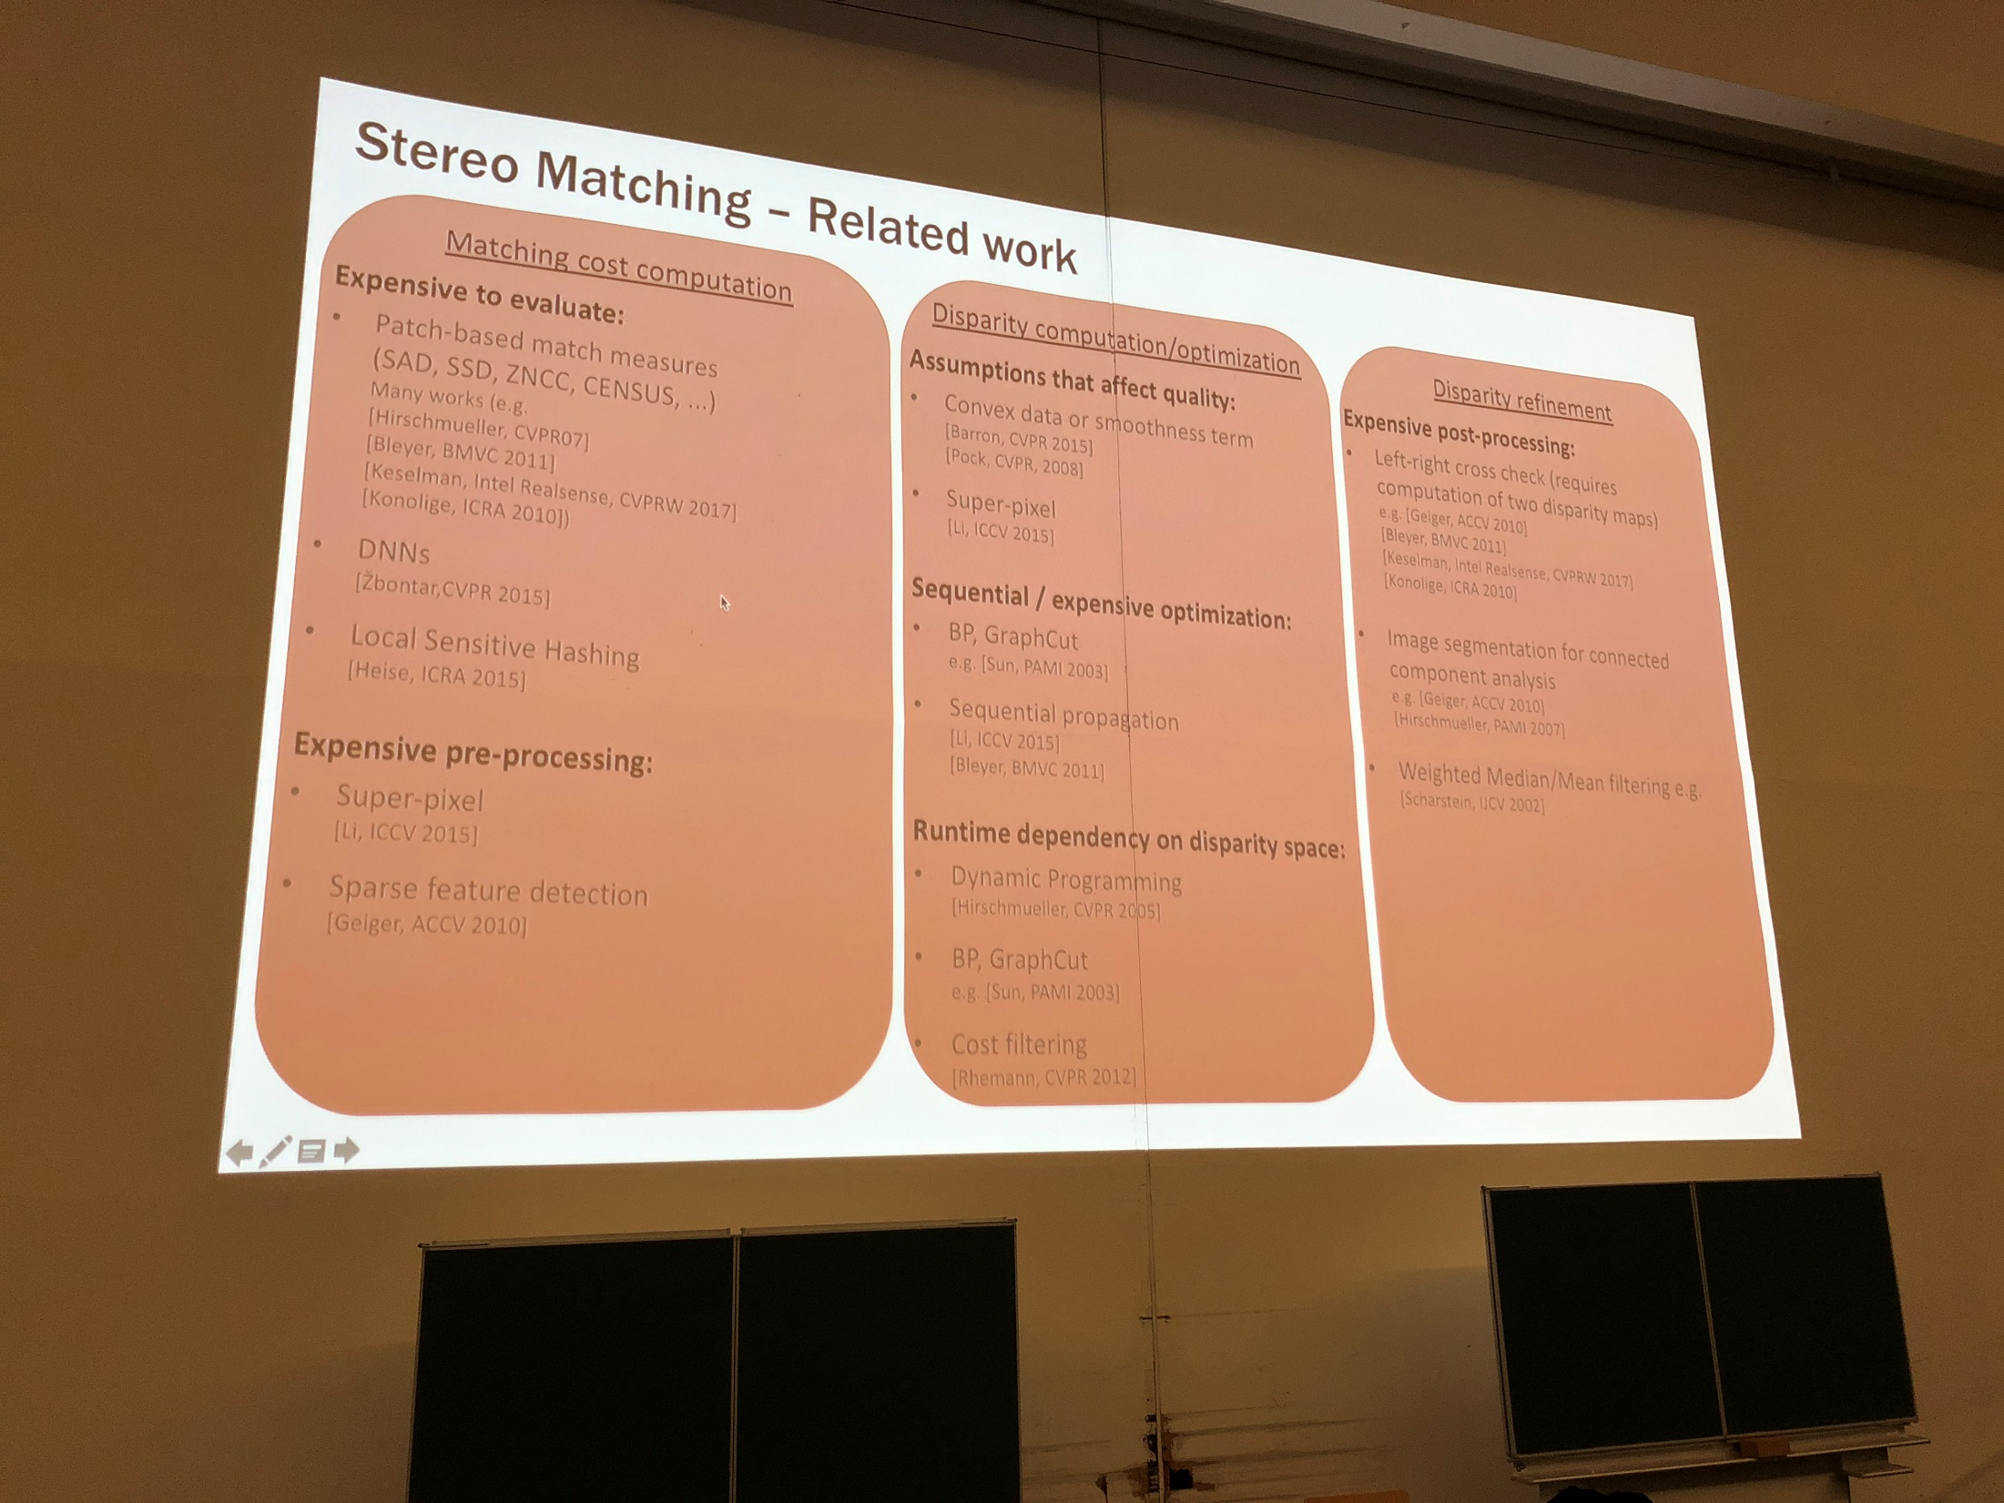

Slide 36
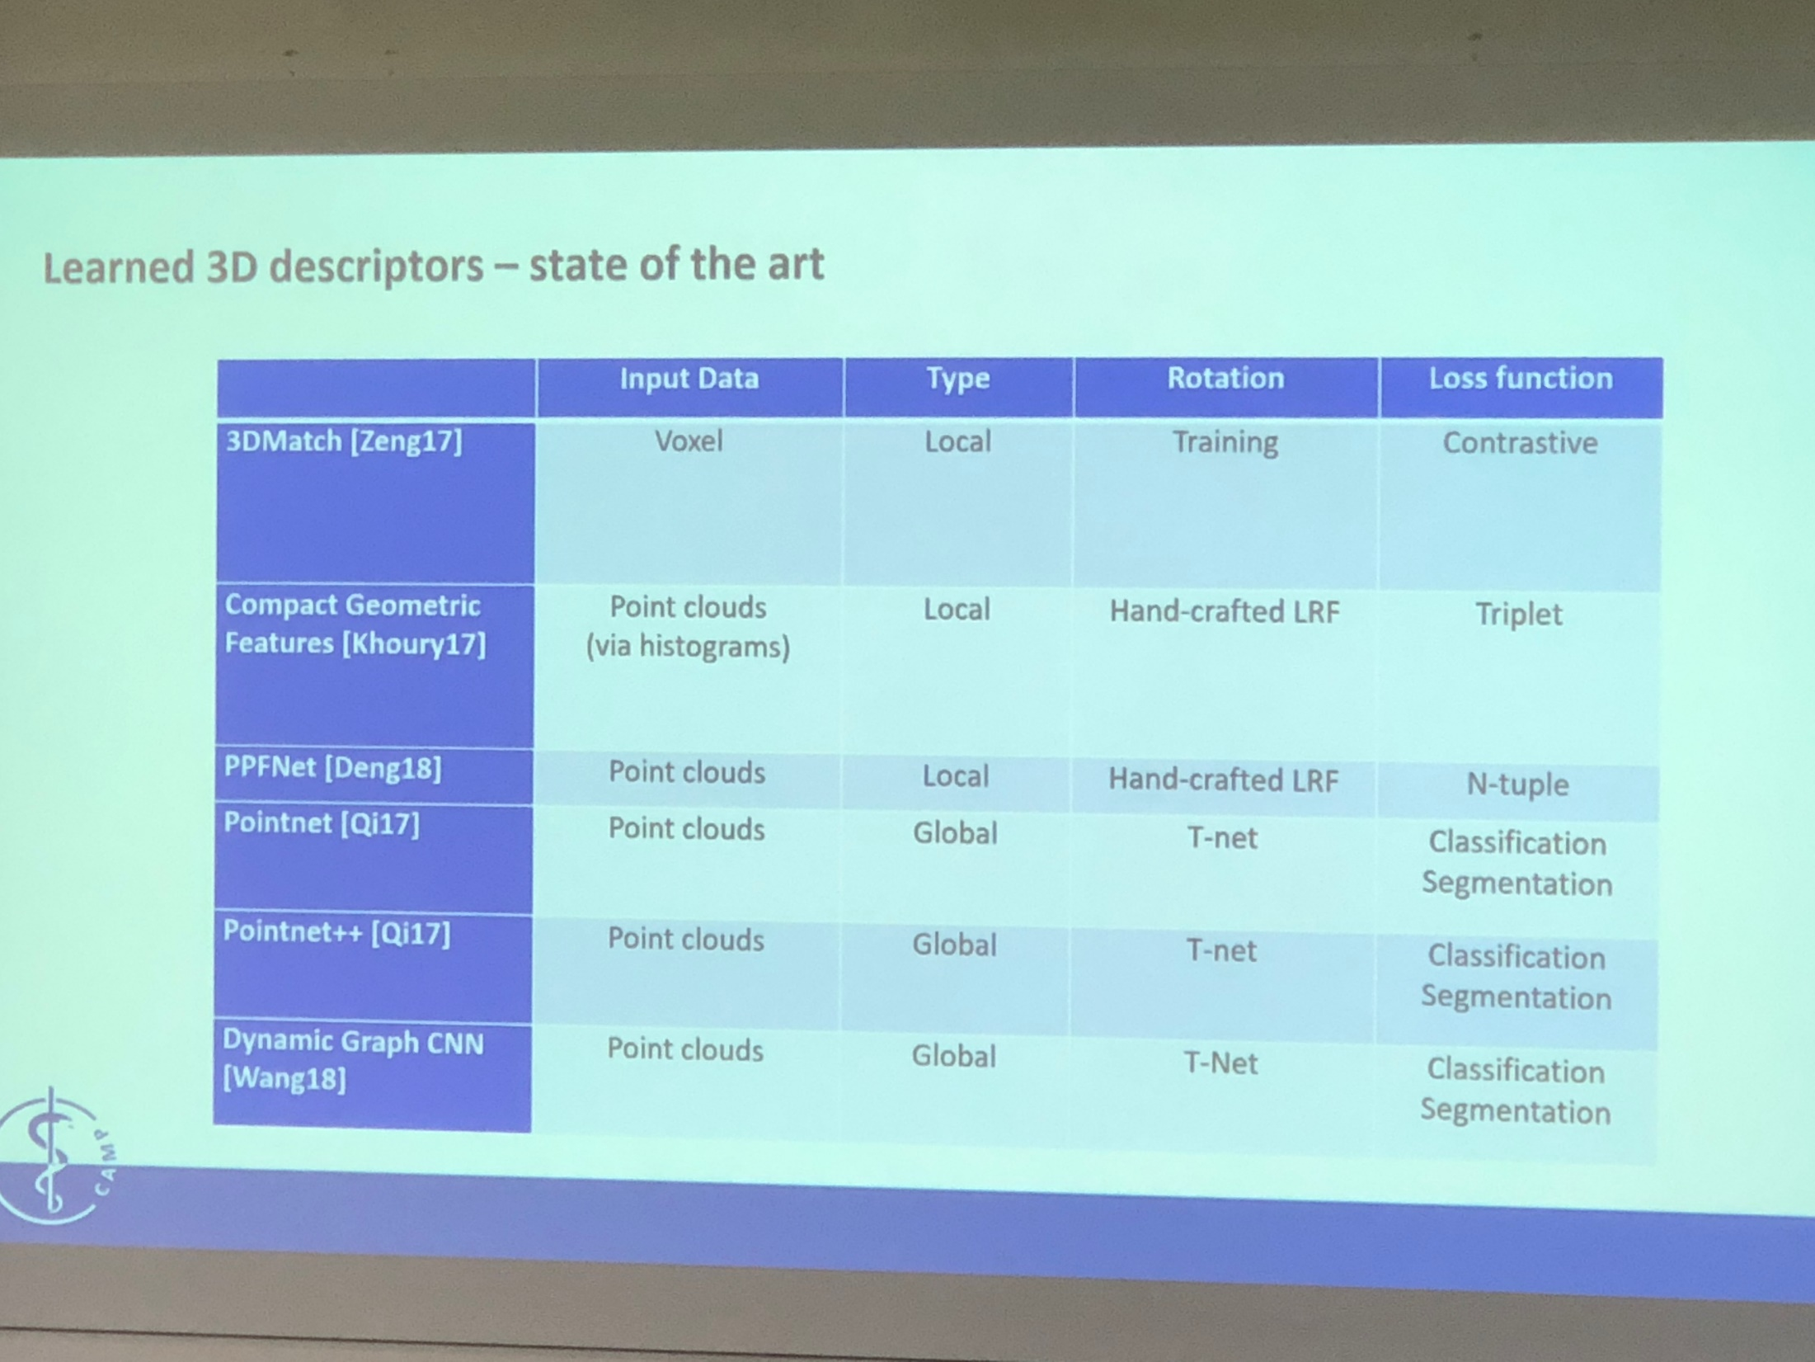

Slide 37
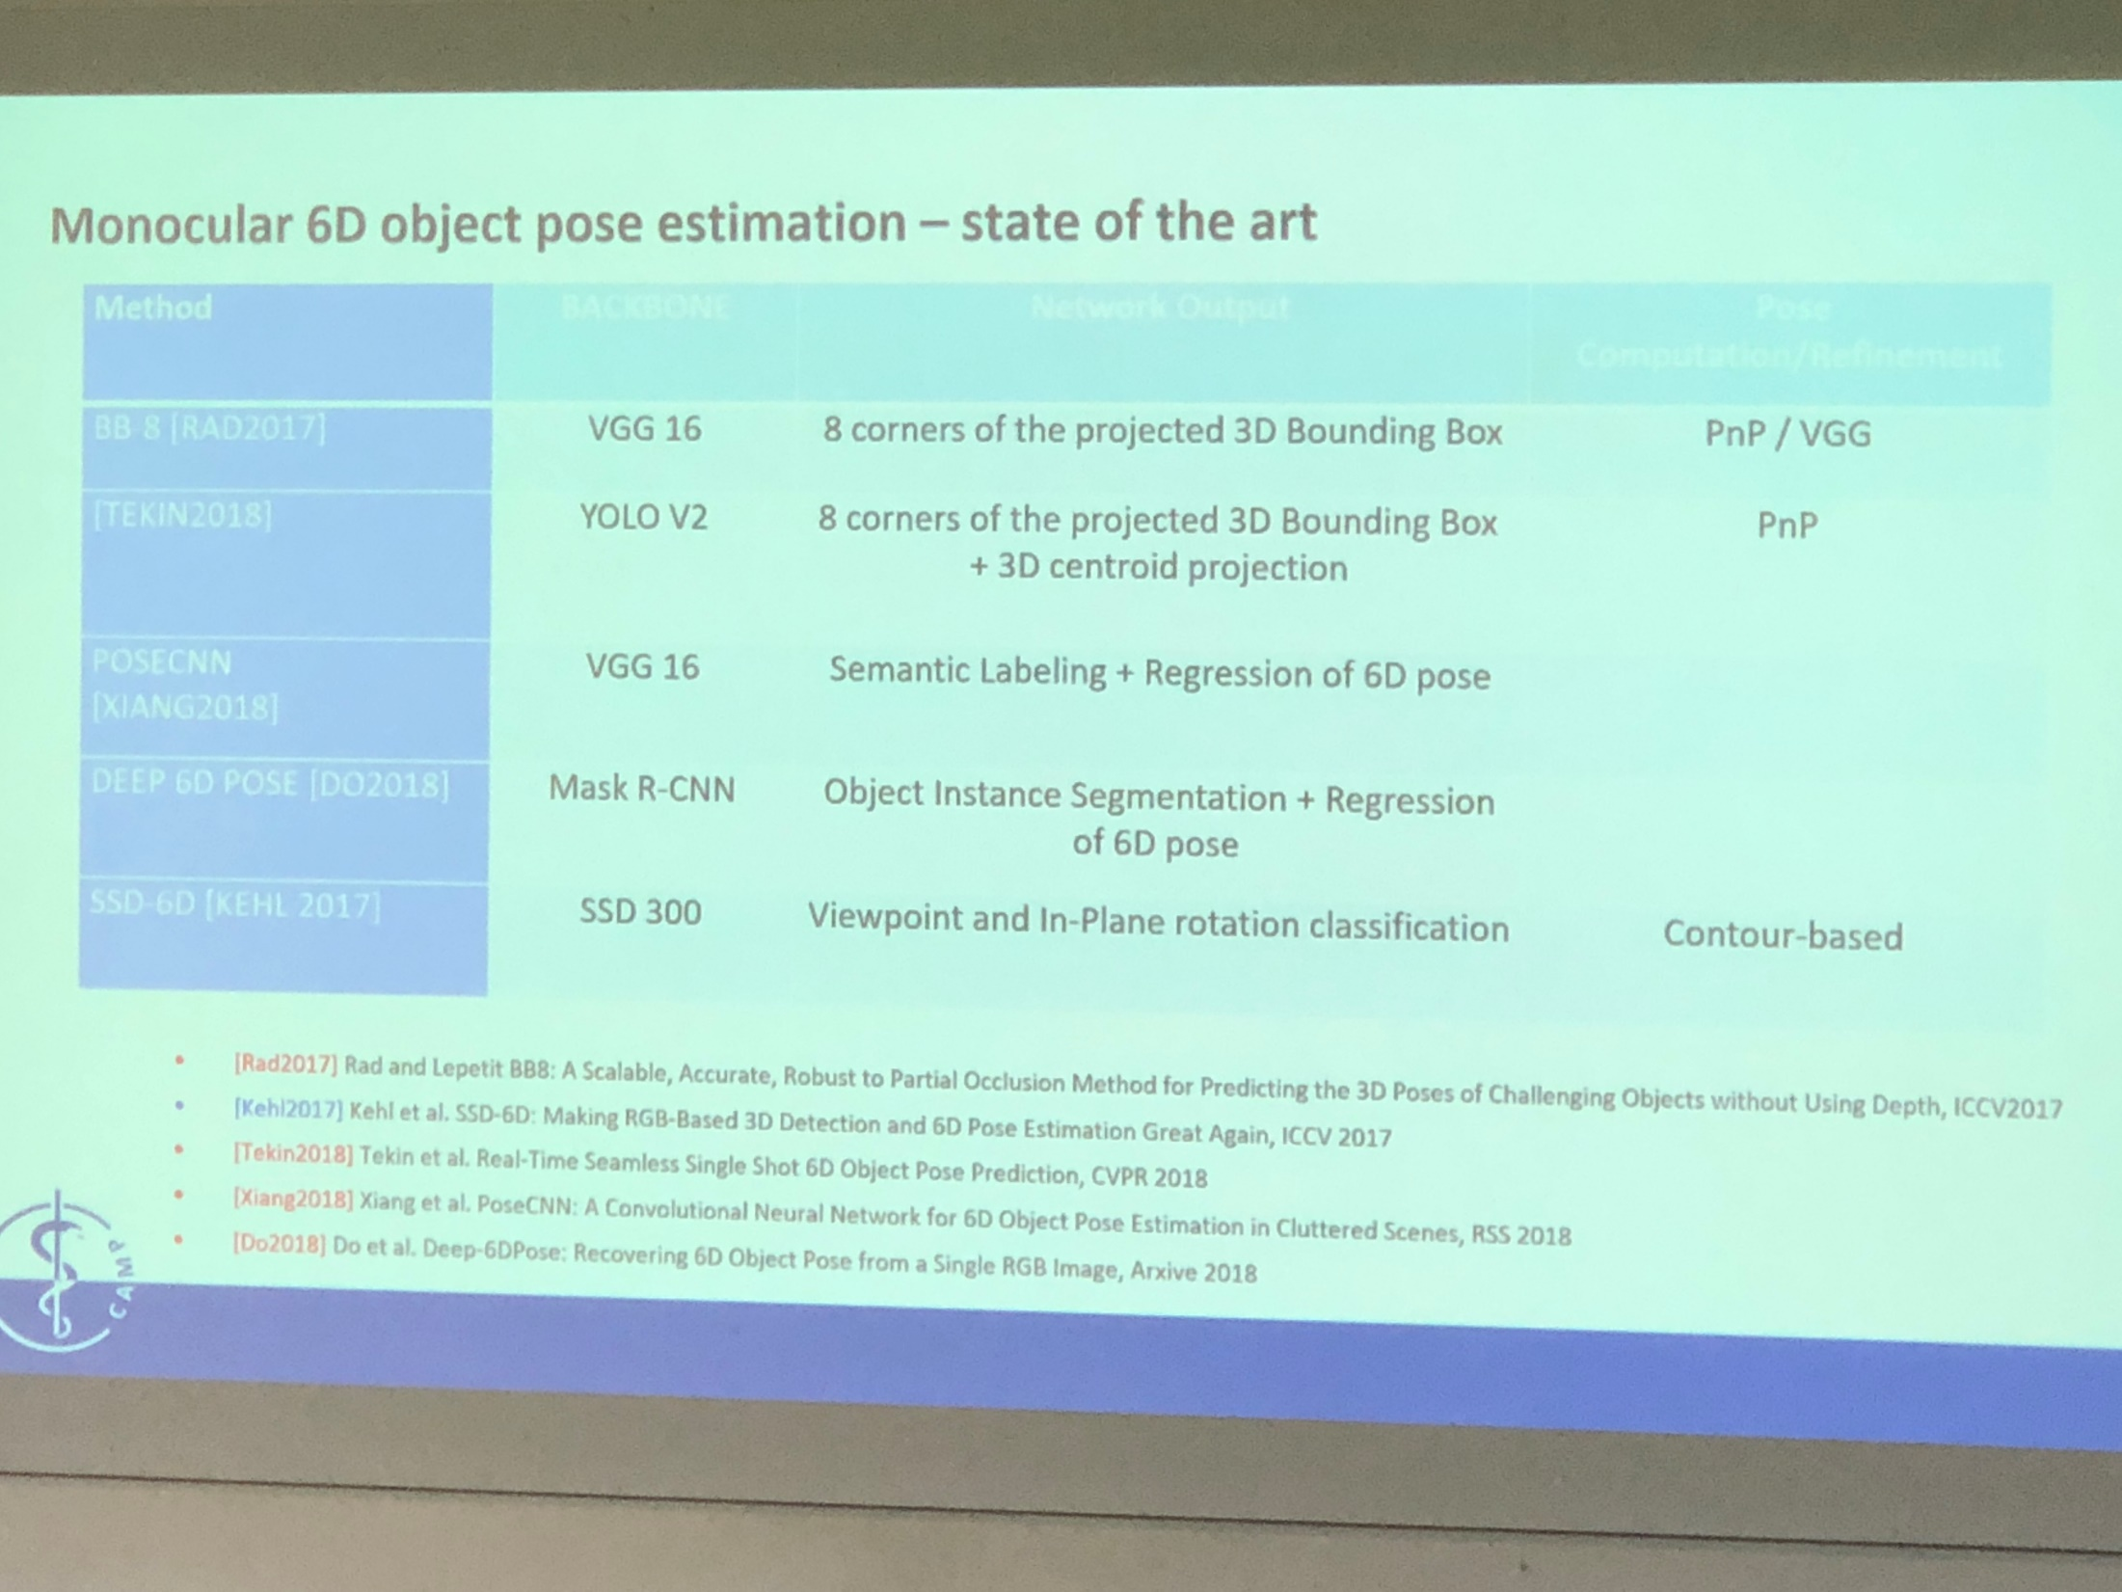

Slide 38
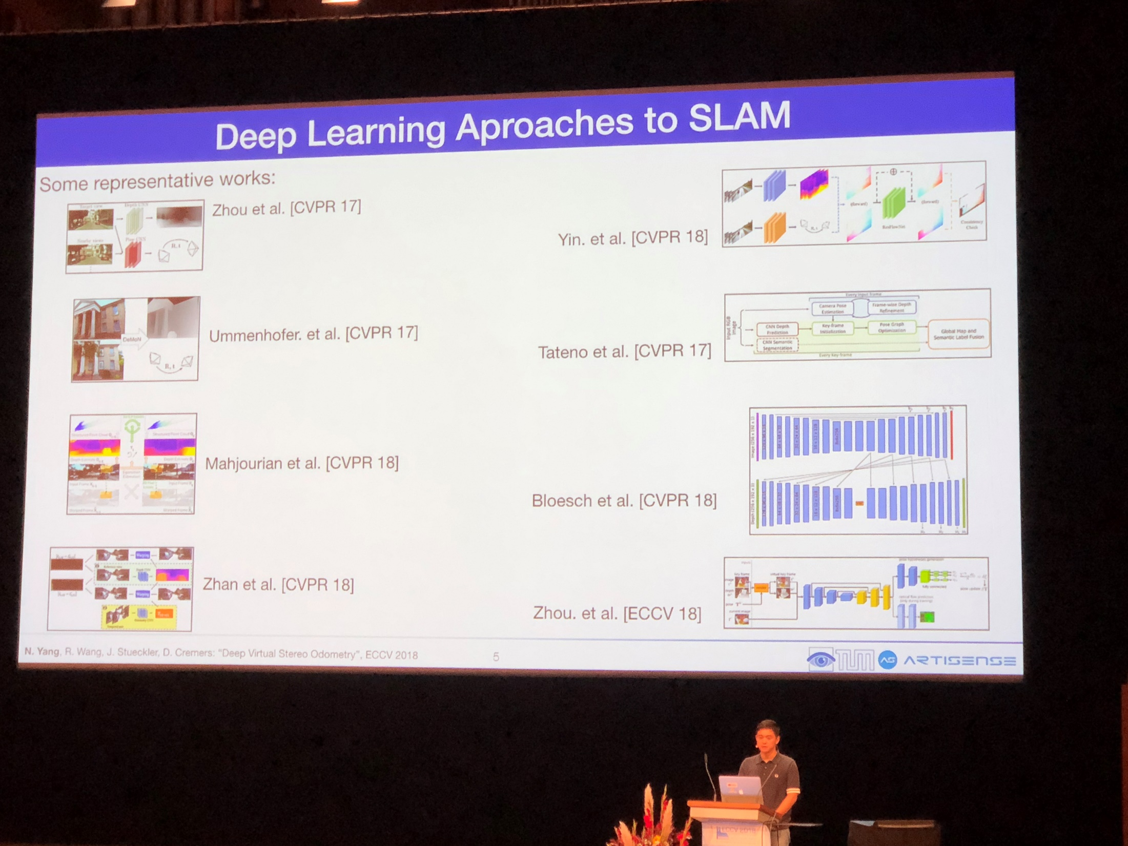

Slide 39
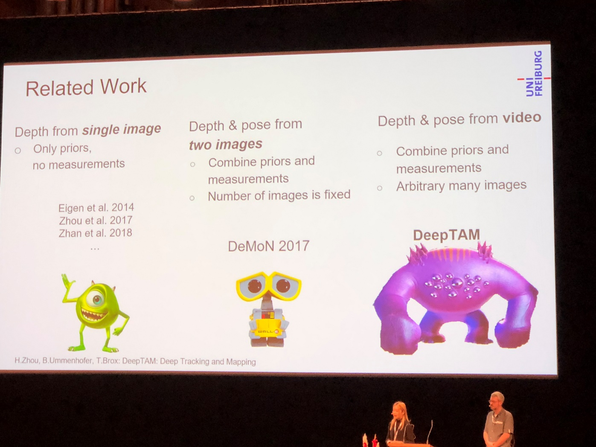
T. Zhou, B. Ummenhofer, and T. Brox, “DeepTAM: Deep Tracking and Mapping,” in ECCV, 2018.

